Slide 1
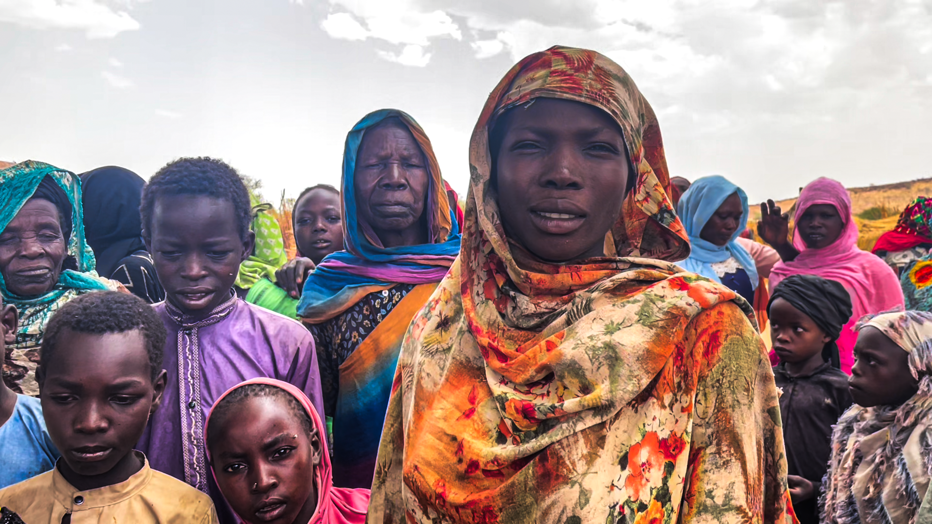
Thank you!
Together, we raised $100,000 in support of CLWR’s response to the crisis in East Africa! Your gifts are helping our partners deliver, food, water, shelter, sanitation and hygiene support to those in need. Please continue to join us in praying for all those affected by this crisis.

